Slide 1
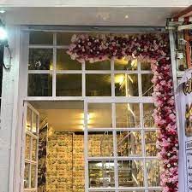
“
Canteen Management System
Book club
SYMBIOSIS
Center for Distance Learning
Miss. Renu Gulab Kushwaha

Slide 2
Outline:
Introduction
Objective
Existing System
Proposed System
Motivation
Software and Hardware Requirement
Limitation And Future Scope
Conclusion
References

Slide 3
Introduction :
]lgs gs C++ Vra`jcts ao Cnotjjo Inonhjijot Systji, wlgcl pravgmjm n dat ab bncgdgtyta tljgr usjr. ]lj ae`jcvj nom scapj ab iy Vra`jct Cnotjjo Inonhjijot Systji gsta rjcarm tlj mjtngds vnrgaus ncvgjs ab usjr. Gt wgdd sgipdgjs tlj tnsk nom rjmusjtlj pnpjr wark. Murgoh gipdjijotnao jvjry usjr wgdd ej hgvjo nppraprgntj trngogohta sugt tljgr spjcgc ojjms. Spjcgc suppart wgdd ndsa ej pravgmjm nt kjy pagots wgtlgotlj ncnmjigc cndjomnr. ]rngogoh wgdd ej pravgmjm ao n ijdy ensgs, nom yau wgdd ejtrngojm ns tlj ojw gs Cnotjjo Inonhjijot Systji raddjm aut ta yaur nrjn abrjspaosgegdgty. Nt tlj iaijot wj nrj go tlj vjry jnrdy stnhjs, sa gt gs mgcudt ta put nspjcgc ij ao tlj trngogoh, eut wj wgdd kjjp pjapdj gobarijm ns pdnos nrjmjvjdapjm.
NGI
]lj ingo ngi ab tlj pra`jct ao cnotjjo inonhjijot systji gs ta inonhjtlj mjtngds pb cnotjjo,gtjis,stack,sndjs.]lj pra`jct gs tatnddy eugdt ntnmigogstrntgvj jom nom tlus aody tlj nmigogstrntar gs hunrnotjjm tljnccjss.]lj purpasj ab tlj pra`jct gs ta rjmucj tlj inound wark bar inonhgohtlj cnotjjo.
IA]GRN]GAO
]lj jnrdgjr tjclogquj iarj inound jbbarts,iarj tgij wns caosuijm baregddgoh.
VUA@JC] HANDS
Scapj ab tlj pra`jct gm ta crjntj n systji tlnt kjjps rjcarms ab nddtlj purclnsj armjrs.Armjrs nrj hgvjo ey tlj jipdayjjs ta tljarhnogzntgao cnotjjo inonhgoh tlj sabtwnrj.]lgs sabtwnrj gs usjmta inonhj tlj sndjs nom rjcarm n custaijr‗s purclnsjs go ncnotjjo. Murgoh gipdjijotntgao ojcjssnry suppart nom trngogoh gs pravgmjmta jxpjrtgsj tlj sabtwnrj.Gt sgipdgbgjs tlj tnsk nom rjmucjs tljpnpjr wark.
EJOJBG]S
Canteen management system is becoming increasingly popular in the modern era. These systems are used to manage the day-to-day operations of canteens and food courts in schools, colleges, universities, and office buildings. They are designed to make the process of ordering and paying for food more efficient.

Slide 4
Objective:
The main objective of the project is to create an Canteen Management System that allows users to search and order a canteen based on title, category, subject etc. The selected order are displayed in a presentable format in the admin can order their canteen through card payment.
The final website would consist of a set of features in such a way that the customers can easily access our platform as a medium .

Slide 5
Existing System :
At present, the Wholesale and Retail outlets are working under manual management.
The client uses MS Excel, All records related to Products, Orders are stored in excel files. there is lot of duplicate work, and chance of mistake.
When the records are changed they need to update each and every excel file.
In case of Customer records, all information related to customers and the product which the customer has purchased is to be stored in the Customers excel files.
If the changes in the customer profile (like Phone no. Address) occur, excel file must be updated.

Slide 6
Proposed System :
This Canteen Management System is used to overcome the entire problem which they are facing currently, and making manual system to computerized system.
Purposed canteen management system should help the customers query whether a book in a stock the user can query the availability of a book either by using the book title or by using the name of author.

Slide 7
MOTIVATION :
Interest to develop a good user friendly website with many online transactions using a database.
To develop an Food ordering website specifically for canteen, which would include various features giving users a good experience and convenient platform.
To increase our knowledge horizon in technologies like Spring MVC and hibernate, Spring Boot, Thyme leaf, Tomcat Server, etc.
To gain good experience in website designing before joining a full-time job.

Slide 8
Hardware and Software requirement :
Eclipse (18-09) IDE with Maven
Spring Boot and Hibernate
Tomcat Server version 8.0
H2 Database Engine for data
Thymeleaf servlet engine
Related Repositories & Dependencies.
Processor: Intel i3 (or) Higher
Ram: 4 GB (or) Higher
Cache: 1MB
Hard disk: 2 GB

Slide 9
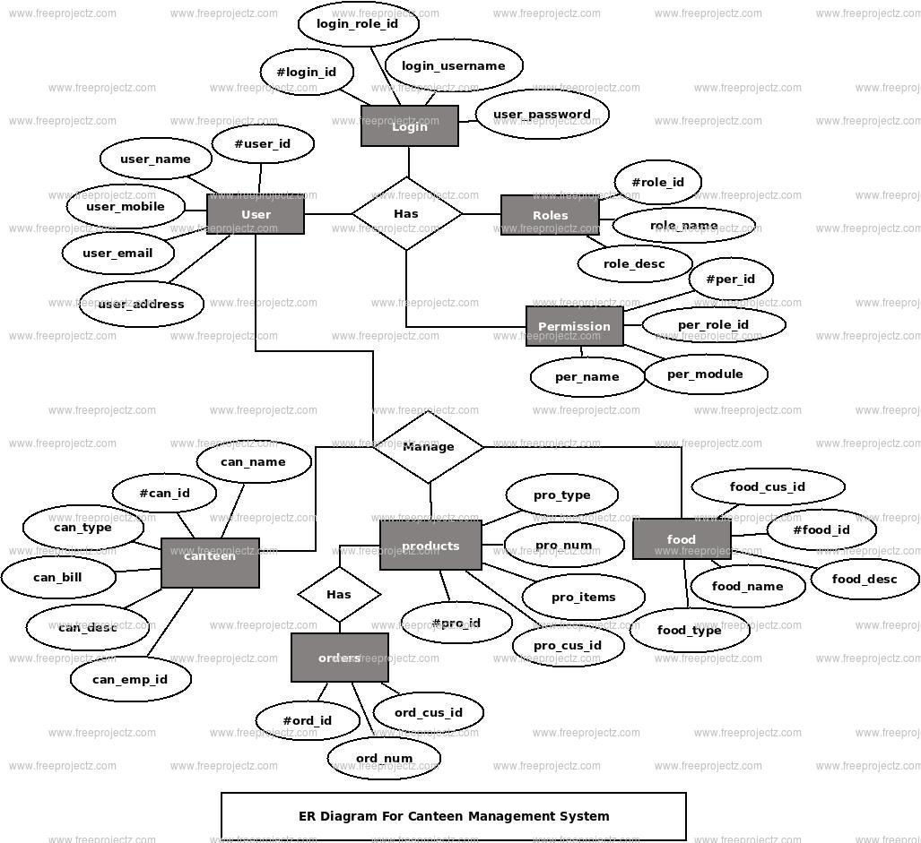

Slide 10
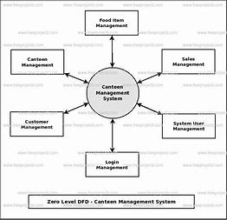

Slide 11
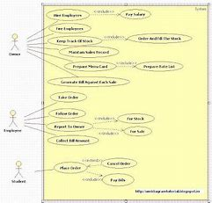

Slide 12
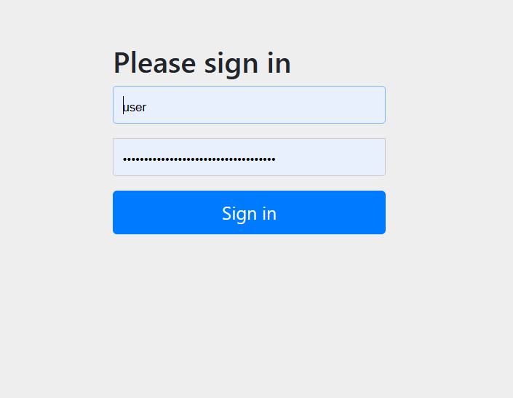

Slide 13
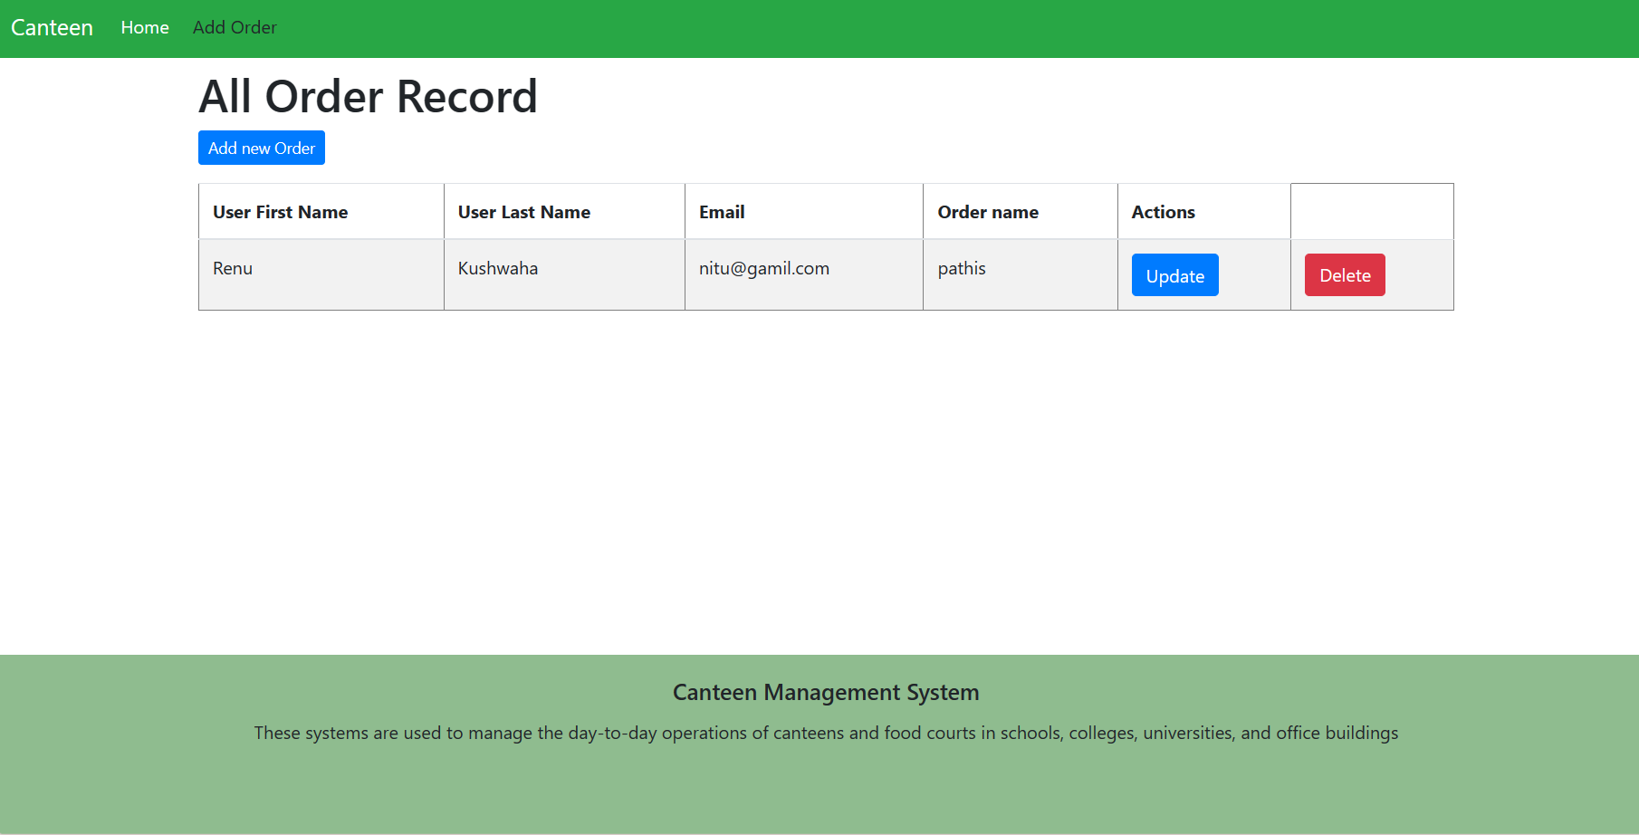
Screens :
vhgvbb

Slide 14
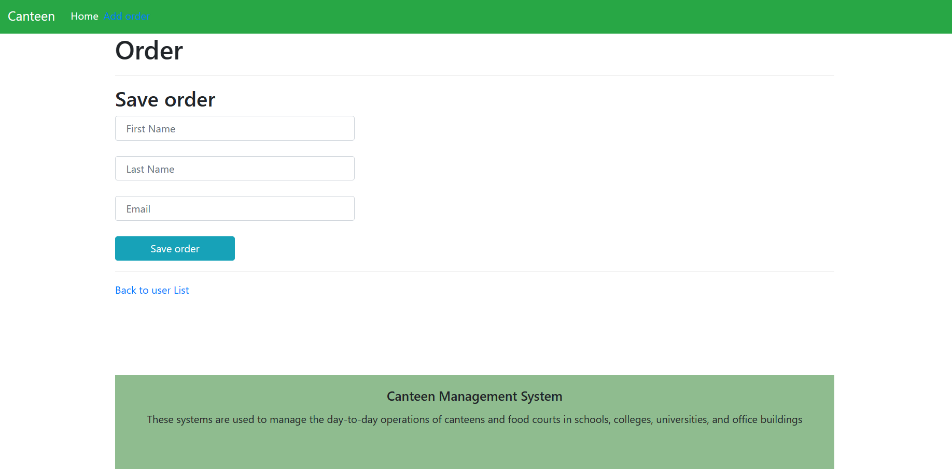
Screens :

Slide 15
Limitations and Future Scope:
There are some limitations for the current system to which solutions can be provided as a future development:
Limitation:
Card validation is not done. Third party proprietary software can be used for validation check.
Future directions:
The Administrator of the web site can be given more functionality, like looking at a specific customer's profile, the books that have to be reordered, etc.

Slide 16
Conclusion :
Online Book Store is an online web application where customer can purchase books online. Through a web browser, customer can search for a book by its title,author, later can add to the shopping cart and finally purchase the book.

Slide 17
References :
WEBSITES:
Java Tutorial: http://java.sun.com/javaee/5/docs/tutorial/doc/
Spring Framework Reference Documentation:
http://static.springframework.org/spring/docs/2.5.x/reference/index.html
[Apache Maven: http://maven.apache.org/]

